Slide 1
VMware Virtualization Overview
Lecture by
Pallavi Mudhol

Slide 2
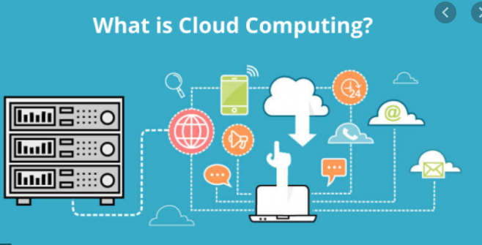

Slide 3
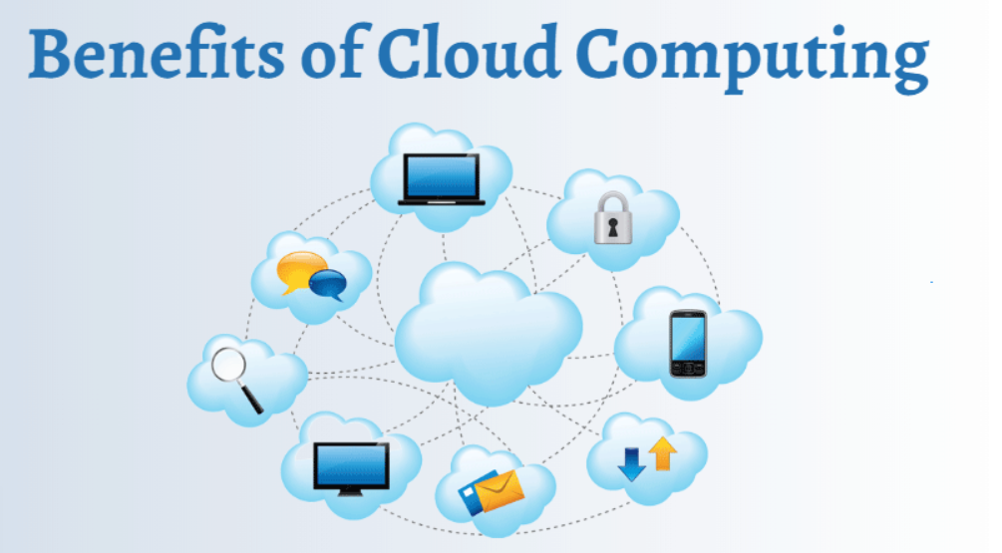

Slide 4
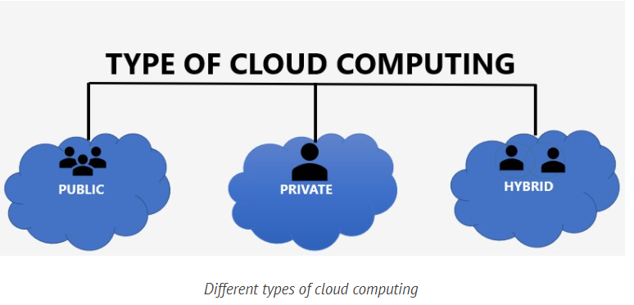

Slide 5
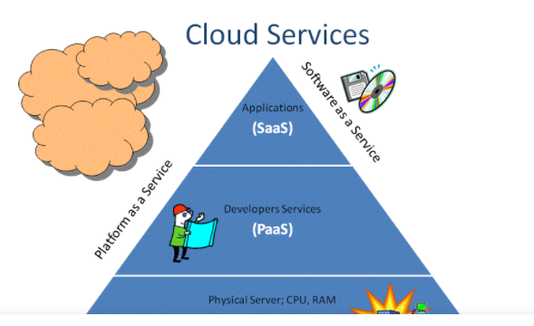

Slide 6
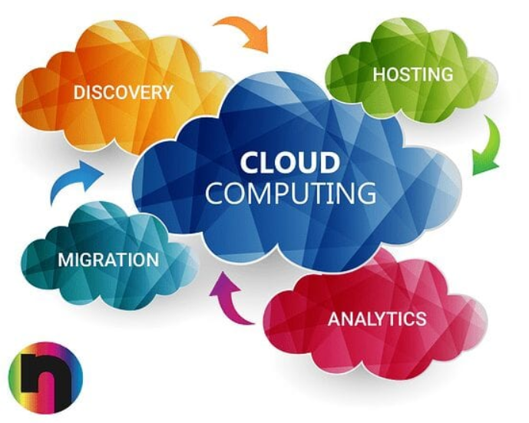

Slide 7
Virtualization Techniques in Cloud Computing

Slide 8
The Basics of Virtualization

Slide 9
Virtualization vs. Cloud Computing

Slide 10
Types of Virtualization in Cloud Computing

Slide 11
Advantages and Disadvantages of Cloud Computing

Slide 12
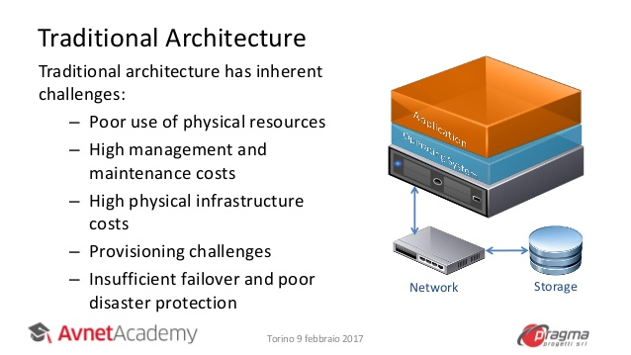
Traditional Architecture

Slide 13
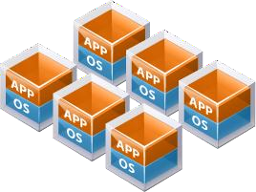
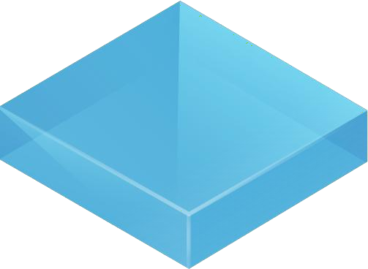
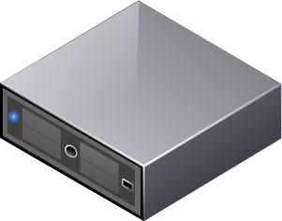

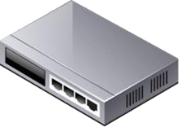
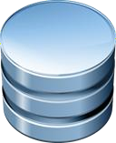
Virtual Architecture
Virtual architecture has inherent benefits:
Expanded use of physical resources
Reduced management and maintenance
costs
Improved desktop manageability and
security
Increased availability of applications
Increased operational flexibility
Network
Storage

Slide 14
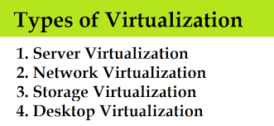
Types of Virtualization

Slide 15
Server Virtualization
Server virtualization allows for many virtual machines to run on one physical server.
The virtual servers share the resources of the physical server, which leads to better utilization of the physical servers resources.
The resources that the virtual machines share are CPU, memory, storage, and networking.
All of these resources are provided to the virtual machines through the hypervisor of the physical server.

Slide 16
Network virtualization
The ability to run multiple virtual networks that each has a separate control and data plan. It co-exist together on top of one physical network . It can be managed by individual parties that potentially confidential to each other. Network virtualization, provides a facility to create and provision virtual networks—logical switches, routers, firewalls, load balancer, Virtual Private Network (VPN), and workload security within days or even in weeks.

Slide 17
Storage virtualization is an array of servers that are managed by a virtual storage system. The servers aren’t aware of exactly where their data is stored, and instead function more like worker bees in a hive. It makes managing storage from multiple sources to be managed and utilized as a single repository. storage virtualization software maintains smooth operations, consistent performance and a continuous suite of advanced functions despite changes, break down and differences in the underlying equipment.

Slide 18
Desktop virtualization allows the users’ OS to be remotely stored on a server in the data center. It allows the user to access their desktop virtually, from any location by different machine.
Users who wants specific operating systems other than Windows Server will need to have a virtual desktop.
Main benefits of desktop virtualization are user mobility, portability, easy management of software installation, updates and patches.

Slide 19
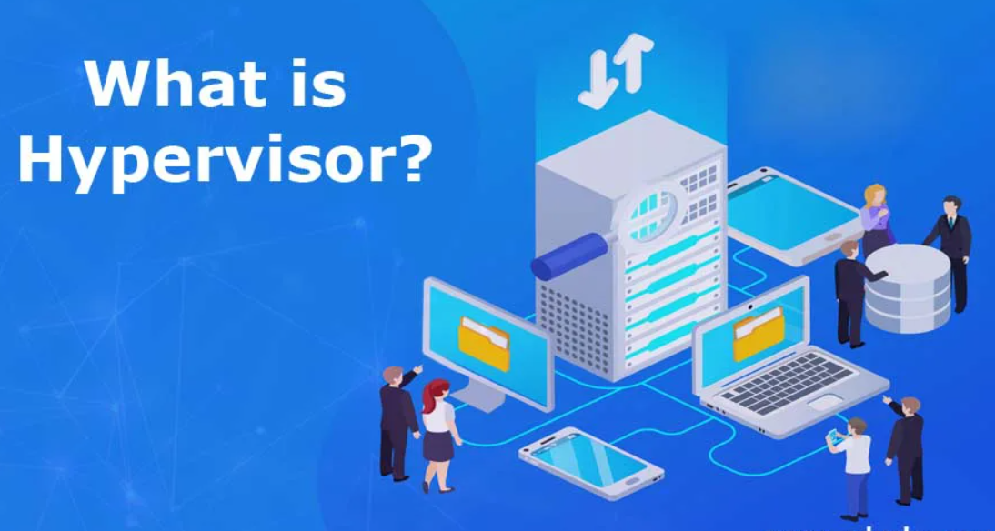

Slide 20
A hypervisor (or virtual machine monitor, VMM) is a computer software, firmware or hardware that creates and runs virtual machines. A computer on which a hypervisor runs one or more virtual machines is called a host machine, and each virtual machine is called a guest machine.

Slide 21
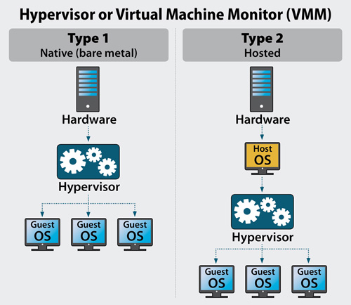
About Hypervisors

Slide 22
There are two principal types of hypervisor: Type 1 and Type 2 hypervisors.
Type 1 hypervisors are deployed directly atop the system's hardware without any underlying operating systems or other software. These are called "bare-metal" hypervisors and are the most common and popular type of hypervisor for the enterprise data center. Examples include vSphere or Hyper-V.
Type 2 hypervisors run as a software layer atop a host operating system and are usually called "hosted" hypervisors like VMware Workstation Player or Parallels Desktop. Hosted hypervisors are often found on endpoints like personal computers (PCs).

Slide 23
Why use a hypervisor?

Slide 24
How does a hypervisor work?

Slide 25
Benefits of hypervisors
Speed
Efficiency
Flexibility
Portability

Slide 26
About Virtual Machines
Virtual machines are software computers that provide the same functionality as physical computers. Like physical computers, they run applications and an operating system.
Multiple virtual machines can run on the same host system concurrently.
A virtual machine has its own virtual hardware, including a virtual CPU, memory, a hard disk and a network interface card.

Slide 27
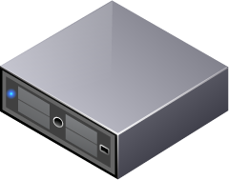
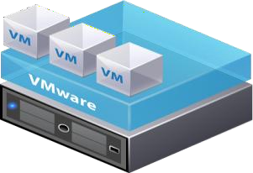
Benefits of Using Virtual Machines
Physical machines
Difficult to move or copy
Bound to a specific set of hardware components
Often has a short lifecycle Requires personal contact to upgrade hardware
Virtual machines
Easy to move or copy
Encapsulated into files
Independent of physical hardware
Easy to manage
Isolated from other virtual machines running on same physical hardware
Insulated from physical
hardware changes

Slide 28
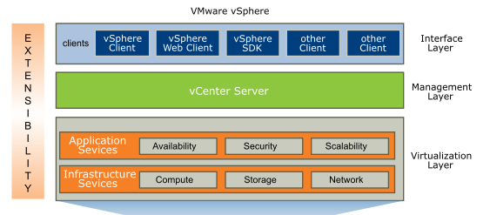
VMware Virtual Infrastructure

Slide 29
VMware vSphere manages large collections of infrastructure, such as CPUs, storage, and networking, as a seamless and dynamic operating environment, and also manages the complexity of a datacenter.
The VMware vSphere software stack is composed of the virtualization, management, and interface layers.
Virtualization Layer
The virtualization layer of VMware vSphere includes infrastructure services and application services. Infrastructure services such as compute, storage, and network services abstract, aggregate, and allocate hardware or infrastructure resources. Infrastructure services include the following types:
Compute services
Includes the VMware capabilities that abstract away from underlying disparate server resources. Compute services aggregate these resources across many discrete servers and assign them to applications.

Slide 30
Storage services
The set of technologies that enables the most efficient use and management of storage in virtual environments.
Network services
The set of technologies that simplify and enhance networking in virtual environments.
Application services are the set of services provided to ensure availability, security, and scalability for applications. Examples include vSphere High Availability and Fault Tolerance.
Management Layer
VMware vCenter Server is the central point for configuring, provisioning, and managing virtualized IT environments.
Interface Layer
Users can access the VMware vSphere datacenter through GUI clients such as the vSphere Client or the vSphere Web Client. Additionally, users can access the datacenter through client machines that use command-line interfaces and SDKs for automated management.

Slide 31
What is vSphere?
vSphere is a software suite that comes under data center product.
vSphere is like Microsoft Office suite which has many softwares like MS Office, MS Excel, MS Access and so on.
Like Microsoft Office, vSphere is also a software suite that has many software components like vCenter, ESXi, vSphere client and so on.
So, the combination of all these software components is vSphere. vSphere is not a particular software that you can install and use, “it is just a package name which has other sub components”.

Slide 32
The two core components of vSphere are ESXi and vCenter Server.
ESXi is the virtualization platform where you create and run virtual machines and virtual appliances.
vCenter Server is the service through which you manage multiple hosts connected in a network and pool host resources.

Slide 33
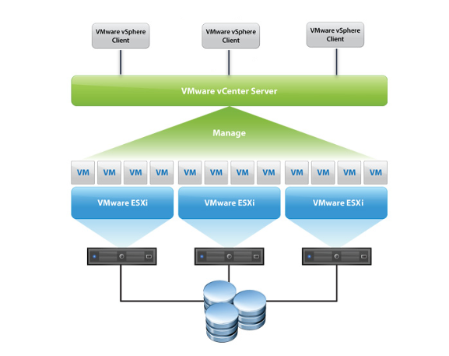
vSphere Infrastructure

Slide 34
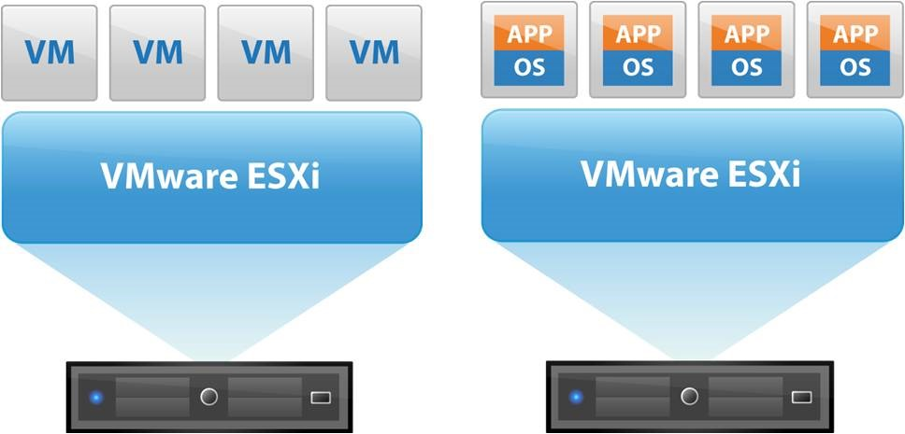
About ESXi

Slide 35
ESXi server is the most important part of vSphere.
ESXi is the virtualization server. It is type 1 hypervisor. All the virtual machines or Guest OS are installed on ESXi server.
To install, manage and access those virtual servers which sit above of ESXi server, you will need other part of vSphere suite called vSphere client.
vSphere client allows administrators to connect to ESXi servers and access or manage virtual machines.

Slide 36
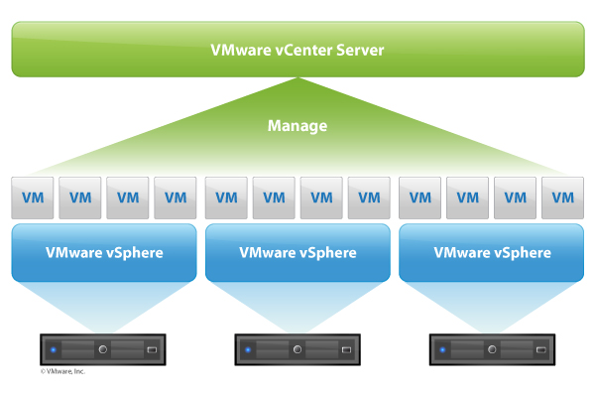
About vCenter Server

Slide 37
vCenter server is another piece of vSphere suite. There are two flavors of vCenter servers.
vCenter server can be installed on Windows Server or can be Linux based virtual appliance.
VMware vCenter server is a centralized management application that lets you manage virtual machines and ESXi hosts centrally.
vSphere client again is used to access vCenter Server and ultimately manage ESXi servers.
vCenter server is compulsory for enterprises that needs enterprise features like vMotion, VMware High Availability, VMware Update Manager, VMware Distributed Resource Scheduler (DRS) etc. For example, you can easily clone existing virtual machine in vCenter server. So vCenter is another important part of vSphere suite. You have to purchase vCenter server license separately.

Slide 38
Accessing vSphere Components
We can access, monitor and manage vSphere components through Vmware vSphere web client, Vmware vSphere client, Vmware vSphere command line interface.
vSphere web client : vSphere web client is a web application that you install on a machine with network access to your vCenter Server system. Only vSphere web client can use all features of current version of vSphere.
vSphere client : You install vSphere client on a windows machine with network access to your ESXi host or vCenter server system. Multiple connections can be established through vsphere client to connect to single vCenter server system or ESXi host.
Vmware vSphere command line interface : vSphere CLI is a command line interface for configuring an ESXi host.

Slide 39
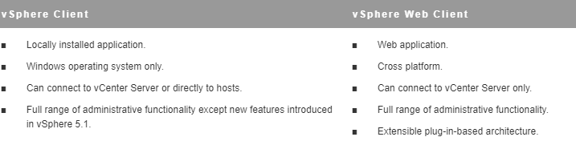

Slide 40
vSphere managed inventory objects
In vSphere, the inventory is a collection of virtual and physical objects on which you can place permissions, monitor tasks and events, and set alarms. You can group most inventory objects by using folders to more easily manage them.
vCenter Server monitors and manages the compute components of your virtual and physical infrastructure with vSphere web client
Cluster
Host
Resource pool

Slide 41
vSphere managed inventory objects: Host & Clusters
Clusters: A collection of ESXi hosts and associated virtual machines intended to work together as a unit. When you add a host to a cluster, the host’s resources become part of the cluster’s resources. vCenter Server manages the resources of all hosts in a cluster as one unit.When you add a host to a cluster, the host’s resources become part of the cluster’s resources. The cluster manages the resources of all hosts.
Hosts : The physical computer on which ESXi is installed. All virtual machines run on hosts or clusters. If the vSphere Client is connected directly to an ESXi host, only that host is available for management.
Resource pool: Resource pools are used to categories the CPU and memory resources of a host or cluster. Virtual machines execute in, and draw their resources from, resource pools. You can create multiple resource pools as direct children of a standalone host or cluster and then delegate control over them to other individuals or organizations.

Slide 42
vSphere managed inventory objects: Storage
Datastores
A virtual representation of underlying physical storage resources in the datacenter. A datastore is the storage location for virtual machine files. These physical storage resources can come from the local SCSI(Small computer system interface) disk of the ESXi host, the Fibre Channel SAN disk arrays, the iSCSI SAN disk arrays, or Network Attached Storage (NAS) arrays. Datastores hide the act or actions of the underlying physical storage and present a uniform model for the storage resources required by virtual machines.
Datastore cluster: A collection of datastores and their underlying storage resources that are present in the data center

Slide 43
vSphere managed inventory objects: Networking
A set of virtual network interface cards (virtual NICs), distributed switches or vSphere Distributed Switches, and port groups or distributed port groups that connect virtual machines to each other or to the physical network outside of the virtual data center.
All virtual machines that connect to the same port group belong to the same network in the virtual environment, even if they are on different physical servers. You can monitor networks and set permissions and alarms on port groups and distributed port groups.

Slide 44
vSphere managed inventory objects: Virtual machines and templates
Templates :A template is a master copy of a virtual machine that can be used to create and provision new virtual machines. Templates can have a guest operating system and application software installed. They can be customized during deployment to ensure that the new virtual machine has a unique name and network settings.
Virtual machines: A virtualized computer environment in which a guest operating system and associated application software can run. Multiple virtual machines can operate on the same managed host machine concurrently.
vApps :vSphere vApp is a format for packaging and managing applications. A vApp can contain multiple virtual machines.

Slide 45
Organizing your Inventory
Data Centers : Unlike folders, which are used to organize specific object types, a data center is an aggregation of all the different types of objects used to work in virtual infrastructure. Within each data center, there are four separate hierarchies.
Virtual machines (and templates)
Hosts (and clusters)
Networks
Datastores

Slide 46
The data center defines the namespace for networks and datastores. The names for these objects must be unique within a data center. You cannot have two datastores with the same name within a single data center, but you can have two datastores with the same name in two different data centers. Virtual machines, templates, and clusters need not be unique within the data center, but must be unique within their folder.
Folders:
Folders allow you to group objects of the same type so you can easily manage them. For example, you can use folders to set permissions across objects, to set alarms across objects, and to organize objects in a meaningful way.
A folder can contain other folders, or a group of objects of the same type: data centers, clusters, datastores, networks, virtual machines, templates, or hosts. For example, one folder can contain hosts and a folder containing hosts, but it cannot contain hosts and a folder containing virtual machines.

Slide 47
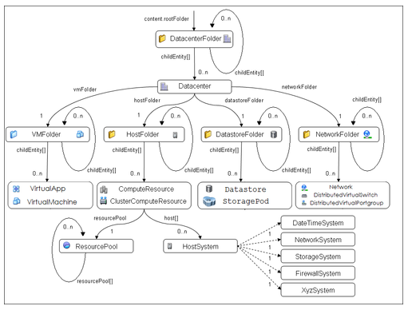

Slide 48
Features of vCenter Server
Vmware vSphere vMotion
Vmware vSphere Storage vMotion
Vmware vSphere High Availability
Vmware vSphere Distributed Resource Scheduler
Vmware vSphere Storage DRS
Vmware vSphere Fault Tolerance

Slide 49
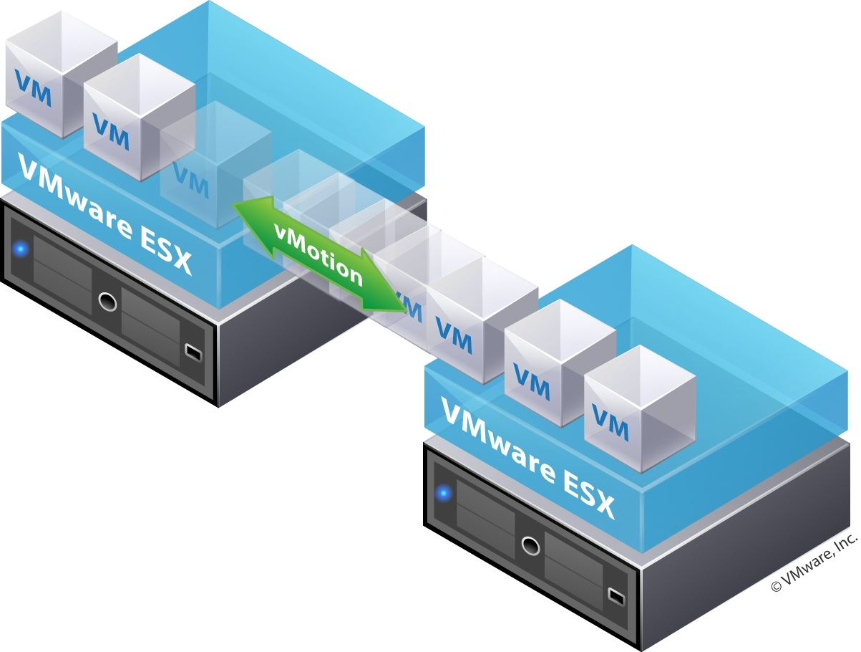
vSphere vMotion
Using vSphere vMotion we can move running virtual machines from one ESXi host to another ESXi host without service interuption, downtime and zero data and connectivity loss

Slide 50
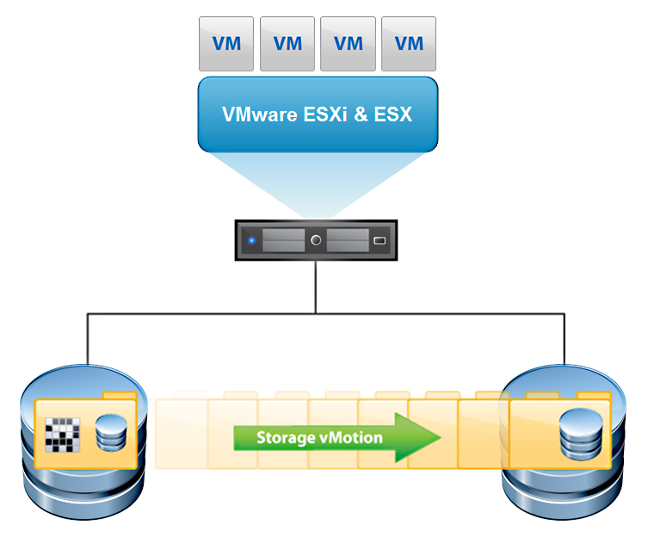
About vSphere Storage vMotion
Migration of a powered-on virtual machine's files from current datastore to a new datastore. In this type ESXi host is not changed, only datastore file location is changed from current datastore to new datastore.

Slide 51
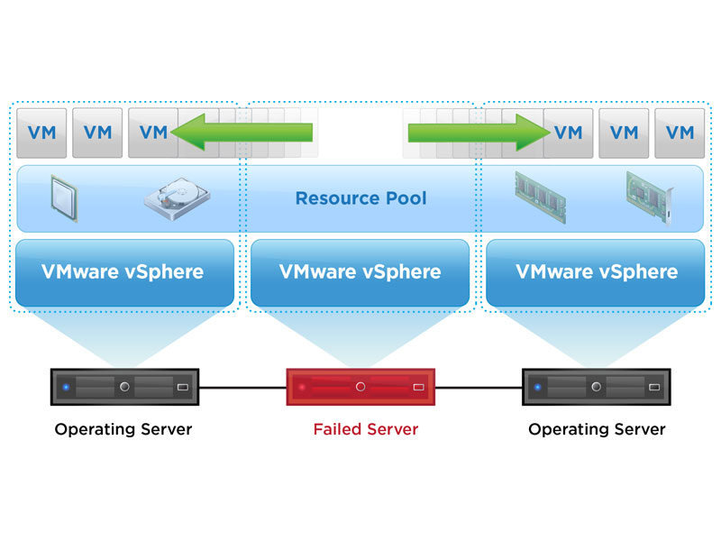
vSphere High Availability

Slide 52
vSphere High Availability
If an ESXi host fails, VMs that were running on that host are automatically restarted on other ESXi hosts in same cluster.
HA works on the cluster created inside the datacenter in vCenter server. Cluster contains the group of ESXi hosts. In the event of failure or crash of ESXi host HA will occur and it will restart the virtual machine on the other available hosts so that the virtual machines can be available if host completely fails. HA will provide you with the minimum downtime is only the restart of the virtual machine which only takes few minutes.

Slide 53
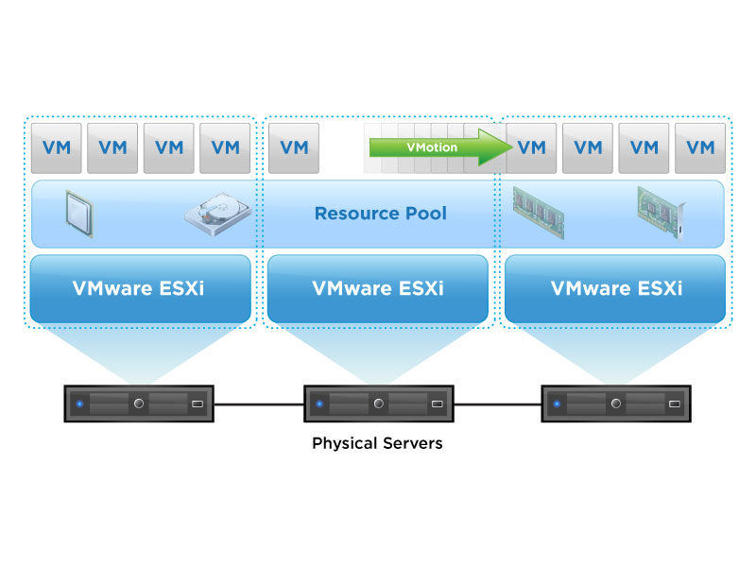
vSphere DRS

Slide 54
Vmware vSphere Distributed Resource Scheduler is advance feature of vCenter which helps to balance the CPU and memory loads of your ESXi hosts.
DRS works on the cluster created in the vCenter server all the Hosts that are added into that clusters are monitored by the DRS to balance the load on the clusters. DRS helps the cluster to place the VM on the host which is free.

Slide 55
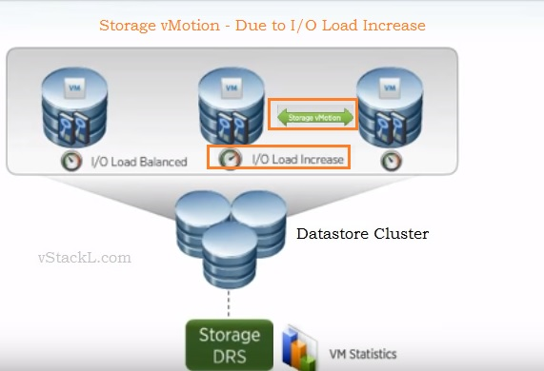
vSphere Storage DRS

Slide 56
With vSphere Storage DRS you can manage multiple datastores as a single resource called a datastore cluster.
Storage DRS allows you to manage the aggregated resources of a datastore cluster, which means that you can balance a space and I/O load between different datastores within a datastore cluster. Also, SDRS manages the initial placement of virtual disks based on space and I/O workload.
The initial placement is a process when you select a datastore within datastore cluster where you want to place a virtual machine disk and the system will propose you the best possible place. SDRS and initial placement are happening when for example you create a new virtual machine (VM) or clone VM. This also happens when a virtual machine disk (VMDK) is migrated to another datastore cluster, or when you add a disk to an existing VM.

Slide 57
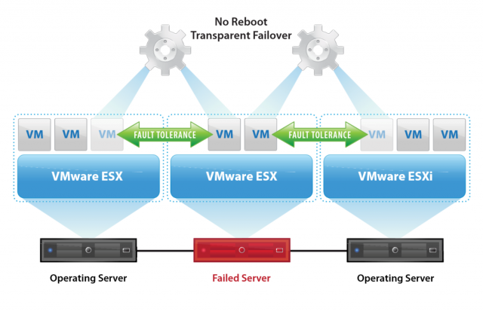
vSphere Fault Tolerace

Slide 58
VMware Fault Tolerance (FT) protects a virtual machine in a VMware HA cluster. VMware FT creates a secondary copy of a virtual machine and migrates that copy onto another ESXi host and datastore.
VMware vLockstep technology ensures that the secondary virtual machine is always running in lockstep synchronization to the primary virtual machine. When the host of a primary virtual machine fails, the secondary virtual machine immediately resumes the workload with zero downtime and zero loss of data.

Slide 59
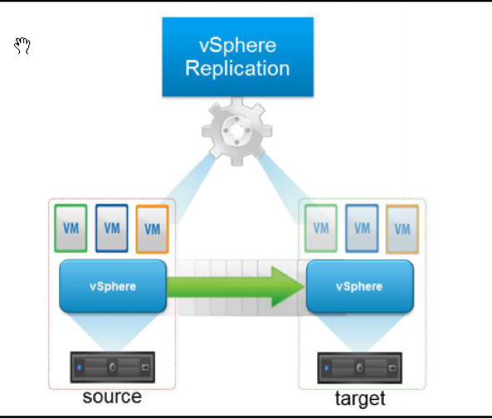
vSphere Replication

Slide 60
VMware vSphere replication is an solution for data protection and disaster recovery for all your virtual machines. vSphere replication delivers flexible, reliable and cost efficient replication
vSphere Replication is an alternative to storage-based replication. It protects virtual machines from partial or complete site failures by replicating the virtual machines between the following sites:
From a source site to a target site.
Within a single site from one cluster to another

Slide 61
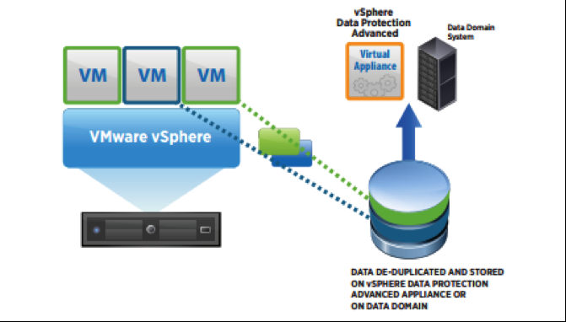
vSphere Data Protection

Slide 62
vSphere Data Protection is a backup and recovery solution designed for vSphere environments.
Powered by EMC Avamar, it provides agent-less, image-level virtual-machine backups to disk. It also provides application-aware protection for business-critical Microsoft applications (such as Exchange, SQL Server and SharePoint) along with WAN-efficient, encrypted backup data replication.
vSphere Data Protection is fully integrated with vCenter Server and vSphere Web Client.

